Slide 1
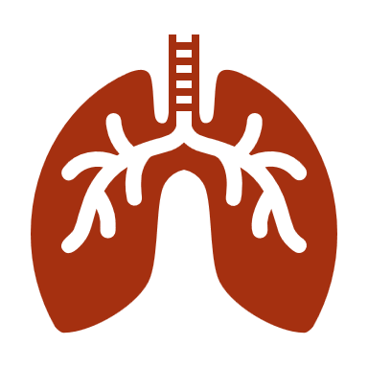
Cheuk-Yin LEE
National University of Singapore
Covid-19:
Humanity and Health
in Traditional Chinese Medicine

Slide 2
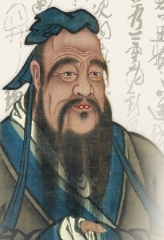
Personal health and humanity
Confucius:
“Your physical body, hair and skin are inherited from your parents. Not allowing anything to do injury to you is where filial piety begins.”

Slide 3
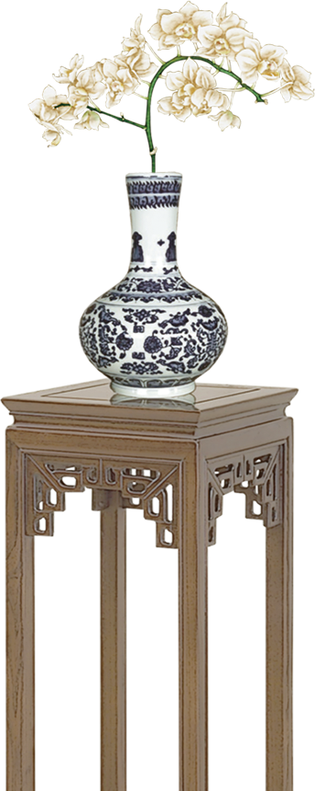
“Prevention is better than Cure”
Five hundred years ago Chinese physician Gao Lian of the Ming Dynasty (1368-1644) already said:
“It is man himself, not Heaven, who governs his life, and he who abuses himself dies young, while he who takes good care of himself enjoys a long life”.

Slide 4
However, this ethical value and obligation is not only confined to your own self, but also extended to others.
Mencius said: “Care for one’s own aged parents and extend the same care to the aged parents of others; love one’s own young children and extend the same love to the children of others.”
Care for the young and old thus became the responsibility and mission of the moral person in Chinese culture.
It is impossible that we just make our own house clean and expect the virus to vanish. The Confucian idea “developing oneself, and seeking also to develop others” is very much in need during this period of time.

Slide 5

Living in Harmony with Nature
According to Chinese philosophy, man having evolved from Nature, should continuously seek to understand, learn and live in harmony with the principles and laws of Nature. Should we continue to fight with each other and exploit Nature, it is only a matter of time that the Earth will no longer be home to man.

Slide 6
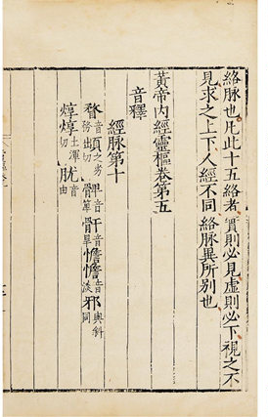
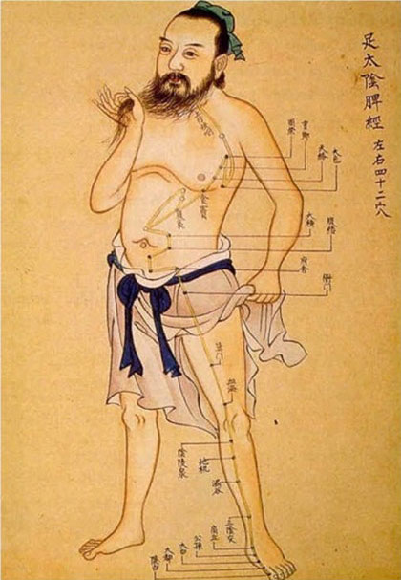
Inner Canon of the Yellow Emperor--Classic of Internal Medicine
The key to a long healthy life is to follow the Tao, the natural way of the universe.
Health and illness are caused by an imbalance of the two basic forces, yin and yang, and by the influence of the five elements on the organs of the body.

Slide 7
Food / Herbs Therapy in Ancient Chinese Culture
Two basic understandings:
1. Medicine and food are from the same origin
药食同源
2. Living in harmony with nature 天人合一

Slide 8
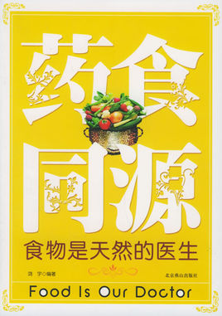
Medicine and food are from the same origin
Inner Canon of
the Yellow Emperor :
“For hungry person, what you eat is food; for sick person, what you eat is medicine.”
“空腹食之为食物，
患者食之为药物。”

Slide 9
Chinese
Food Therapy
食疗
In traditional Chinese knowledge of health, food is viewed as medicine and is used to nourish and harmonize the body, mind, and spirit.
All foods have a distinct energy and characteristic properties that either help to balance our bodies and make us healthy, or that create imbalances which ultimately result in sickness.
Understanding food energetics system: how to enjoy food; how to heal your body through what you eat.

Slide 10
Chinese Food Therapy
Harmonizing our food with nature play an important part in TCM.
For example, the “Shijian Bencao” (Food Material Medica) lists down the various kinds of food and their corresponding health effects. For e.g., sesame can cure debility and asthenia of the viscera; aid gastrointestinal movement, promote movement of Qi in one’s body, clear one’s arteries, get rid of “wind” within the brain, and moisturize one’s skin.
Another example: barley can loosen one’s gastrointestinal organs, harmonise the Qi in one’s body, as well as strengthen one’s Qi and blood.
Walnuts, on the other hand, are good for moisturizing one’s skin, and for promoting the growth of black hair.
Eating wisely to enhance your physical health and immune system will be the advice for everybody during this epidemic crisis.

Slide 11
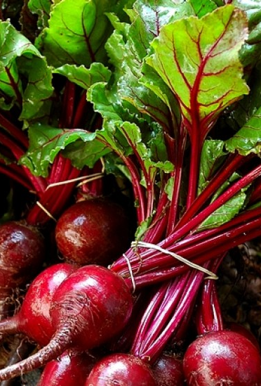
Food Therapy
As food is also medicine, many herbal formulas contain food elements.
E.g. spring allergies can be treated with beet top tea;
Headaches may be alleviated by drinking chrysanthemum tea and eating ginger, garlic and black mushrooms.

Slide 12
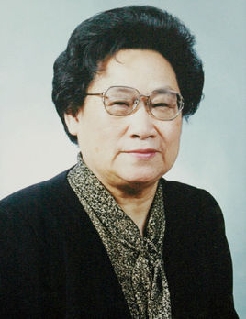
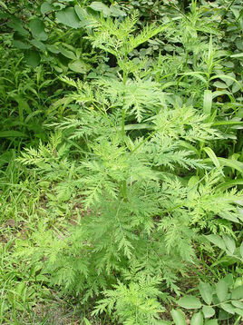
Reflections for Covit-19
In 2015’s Nobel Prize awards for Physiology and Medicine, a manuscript by fourth-century Chinese physician and herbalist Ge Hong 葛洪, the Handbook of Prescriptions for Emergencies, which included a passage on how to treat malaria with an extract made from the sweet wormwood shrub Artemisia Annua was credited for providing a key insight into an anti-malaria drug.
It was the uncovering of this ancient Chinese text that led a contemporary Chinese scientist, Professor Tu Youyou, to the discovery of how to make useful quantities of the drug artemisinin, which has since saved hundreds of thousands of children who would have otherwise died from malaria.
Tu Youyou 屠呦呦

Slide 13
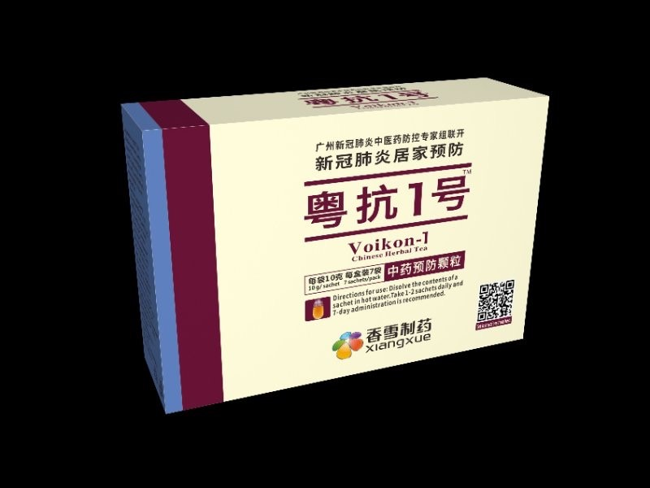
Reflections for Covit-19
Two Chinese herbal remedies that claim to prevent and treat Covit-19 are already in the market.
The Feiyan No.1 (Pneumonia No.1) was produced by the No.8 People’s Hospital of Guangzhou, China. Its clinical trial with 50 patients indicates that all patients’ body temperature returns to normal within a week; 50% of the patients’ cough disappear; 52.4% of the patients’ sore throat disappear; 69.6% of the patients’ fatigue disappear; and none of the patient’s situation deteriorated.
Another one is Voikon-1
As they are basically herbal drinks for cough and heat, their effect remains to be seen.

