Slide 1

COVID-19 and Learning to Be Human
Harold P. Sjursen
北京航空航天大学
Harold-Sjursen.org
harold.sjursen@nyu.edu

Slide 2
ABSTRACT
The XXIV World Philosophy Congress in Beijing during August, 2018 had the general theme, “Learning to Be Human.” Although this theme resonates with principles of both Confucian and classical Greek philosophy, at the time there were some who found the issue quaint, somehow superseded by modernity and science. As we find ourselves now in the midst of a global, pandemic health crisis, understanding what it means to be human is crucial to our hopes for the future. I want to look at two ethical challenges, surprisingly interlocked, to the future of humanity that are posed by the spread of the novel coronavirus and COVID-19: First is the use of medical AI to diagnose and then determine the necessary treatment protocol and appropriate therapy for those infected; Second, the identification of the virus as caused by an ethnic group and its cultural practices. In this presentation I will outline the traditional philosophical ideal of being human and then show how the growing use medical AI together with rising ethnic/cultural xenophobia threaten this ideal. Finally I will discuss how these apparently disparate phenomena are related and how the fear of COVID-19 might lead to the acceptance of troubling ethical standards.

Slide 3
Introduction: Science and Understanding
Medical AI: A secret weapon against an invisible enemy?
Xenophobia and Racism as Responses to Plagues
To be Human What do we need to Learn?
The paper is organized into these four sections.
In this presentation I follow a different scheme.

Slide 4

I.
a. Medicine is sometimes described as an art or set of arts, often as the healing art(s). Modern medicine is also said to be scientific in the sense that the healing arts are based upon science (for example, knowledge of the human body as explained by biological science).
b. Some disciplines explain while others seek to understand.
c. Where on this spectrum are the humanities found?
d. In clinical medicine and in the humanities personal experience is a factor. Should it be part of medicine?
e. Medical humanities and “learning to be human.”

Slide 5
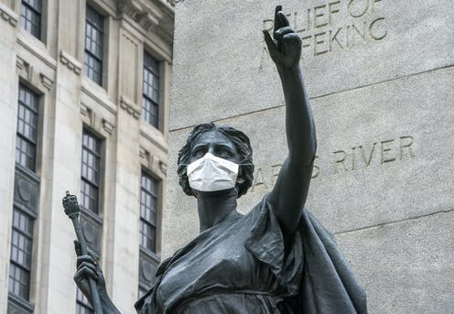
II.
a. How is the corona virus perceived?
b. Invisibility; our lack of knowledge; fear and awe.
c. The war or battle metaphor; healing versus fighting; restoring versus eliminating
III.
a. How two otherwise dissimilar and apparently unrelated phenomena come together.
b. AI
c. Xenophobic racism

Slide 6
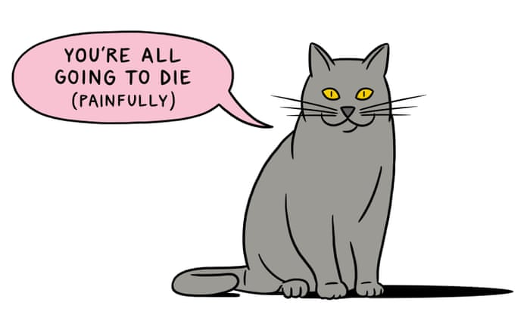
IV.
a. Rationality and superiority
b. The seen and the unseen
c. Master and slave
d. Self and other
V.
a. Affirming life and the human experience

Slide 7
.
Many Thanks 非常感谢
Harold-Sjursen.org harold.sjursen@nyu.edu

