Slide 1


COVID-19 Pandemic: Implications for Humanities
Vice Dean & Professor Tony Hsiu-Hsi Chen
2020/04/17

Slide 2


Containing Strategies for
COVID-19 Pandemic Related to Humanities
Control of COVID-19 Pandemic
No Containment Measures
❶Innate Herd Immunity
•Opposite to ❹❻❽
❷(1) Large-scale outbreak; (2) High fatality (3) Shortage of medical resources
Containment Measures
Border and domestic Quarantine & Isolation
Mitigation Plan
❸(1) Reduce imported infectives, (2) Global digital industry
❹ International Business/ Tourism/ Exhibition/ Conference
❼Reduce community-acquired epidemics
❽Social norm/ Cultural Change
Personal Hygiene and environmental sanitation
Vaccine
Acquired herd immunity
Social distancing
❺(1)Reduce community-acquired epidemics, (2) Innovative digital industry
❻Social /Leisure /Economic behavior change
Partial Containment Measures …
(1) R&D cost, (2) Waiting time

Slide 3
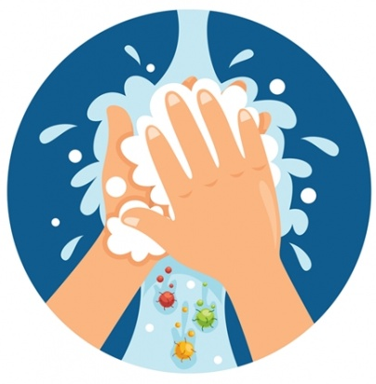
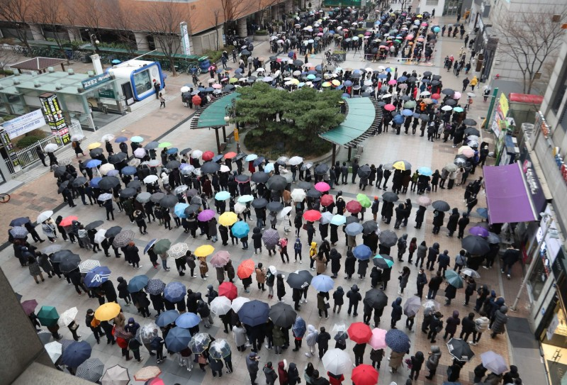
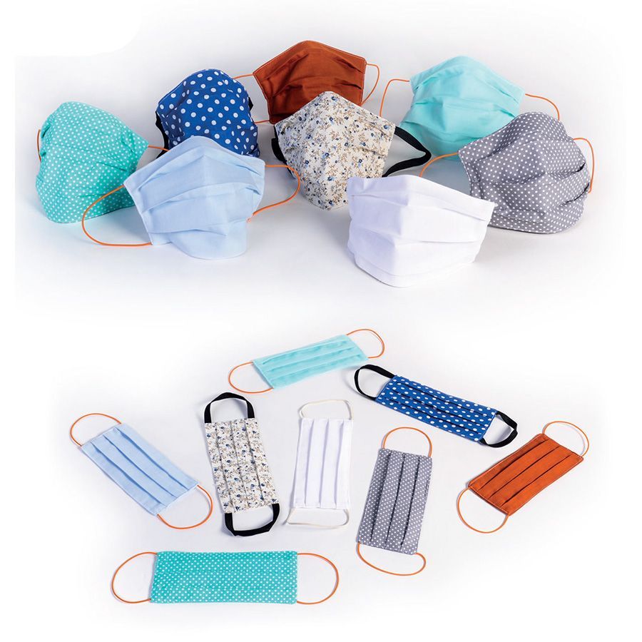
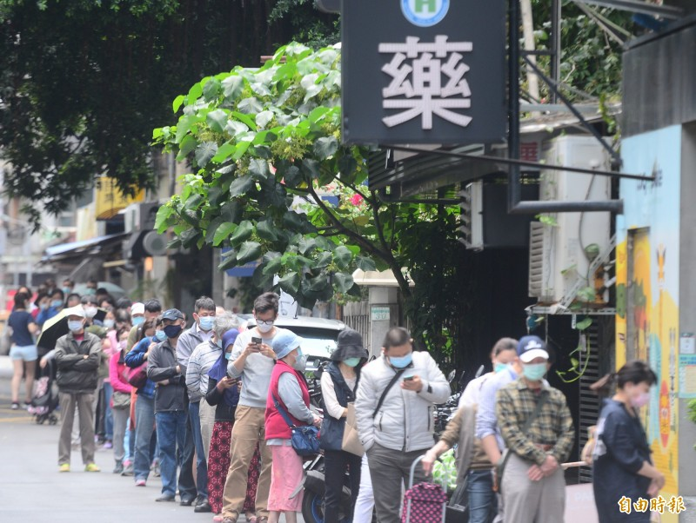
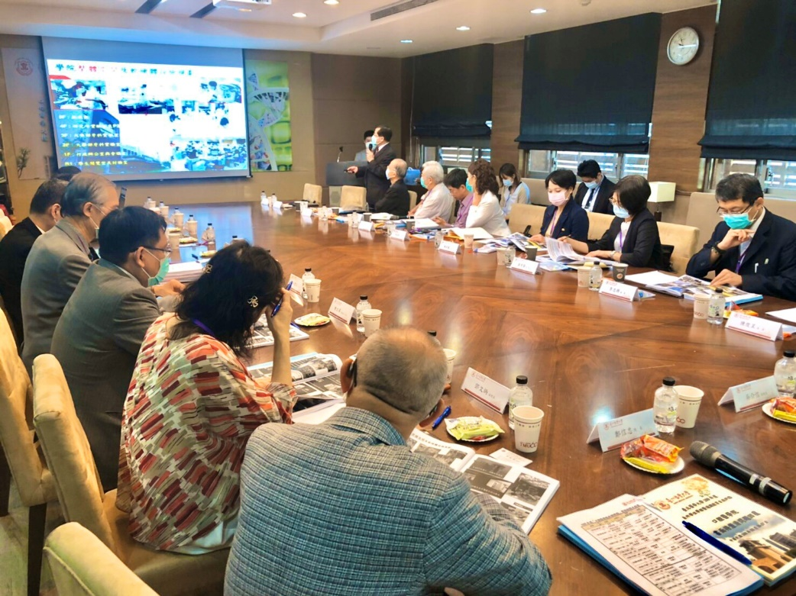
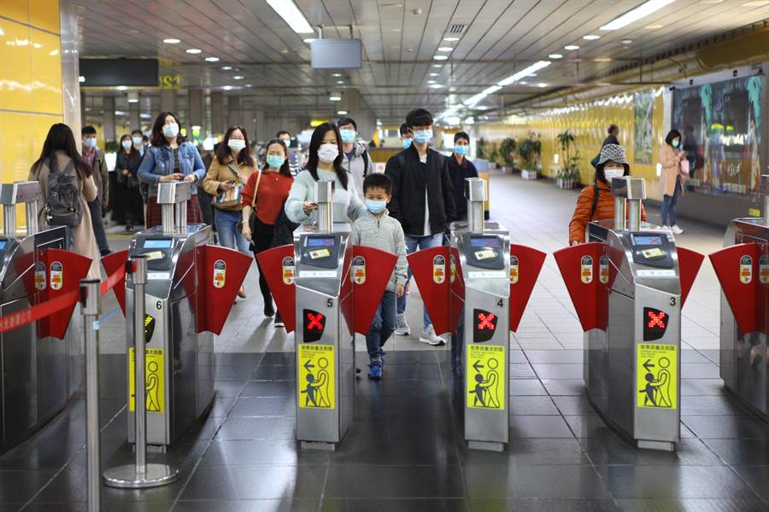
COVID-19:
Cultural Difference in Personal Protection
A long queue for mask
https://news.ltn.com.tw/news/world/breakingnews/3083212
Compulsory policy of putting on mask indoors, Taiwan
Compulsory policy of putting on mask in public transportation, Taiwan
https://www.chinatimes.com/realtimenews/20200403002861-260405?chdtv

Slide 4









Global COVID-19 Public Gathering
Japan
兵庫縣, 愛知縣,
神奈川縣…
USA
麻州Biogen
USA
猶太會堂
Singapore
君悅酒店
國際會議
Malaysia
清真寺集會
USA
Life Care Center
Korea
慶尚北道,
大邱
Korea
新天地教會,恩惠之江教會,
生命泉教會
Conference
Religious
Activities
France
基督教門戶開放教會
Nursing
Home
Singapore
私人晚宴
Korea
Seoul
Singapore
基督生命堂,
神召會恩典堂
Spain
La Liga
Social
Gathering
Netcafe
USA
NBA
Australia
Wedding
Thailand
Boxing
Japan
Osaka
Global
cruise ship
Singapore,
Taiwan,
Spain…
School
Italy
Football Club,
Marathon
PUB
Sports
China,
USA, Iran
Prison
Japan
Gym
Japan
Hokkaido
Thailand
Bangkok
China
Gym
Limited
Space
Korea
Institution
Concert

Slide 5
COVID-19 epidemic curve in S. Korea
2/26: Universal testing
2/4:
Partial board control
2/25:
大邱和慶尚北道地區行最大程度封鎖
3/8: Block a building with outbreak
2/21:
Gathering forbidden
3/17: Schools close
3/19: Boarder control
2/20 Outbreak

Slide 6




















COVID-19 Cluster Infection in Religious Gathering
Epidemiological estimation
Assume 22 people may enter the country on 20th Jan.
After two waves of epidemics, there shall be
76 initial cases
2000 people
Estimation of the 1st wave of cases (2/5 ~ 2/12)
231 cases been infected (R₀ = 6.0)
809 positive cases
Estimation of the 2nd wave of cases (2/13~2/20)
578 cases been infected (R₀ =2.5)
Group transmission rate : 19%/day

Slide 7
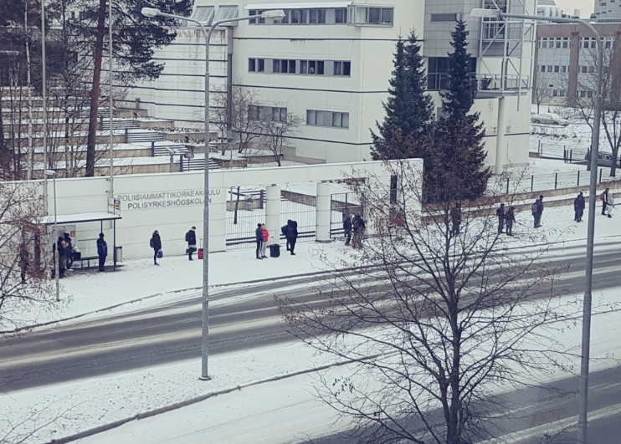
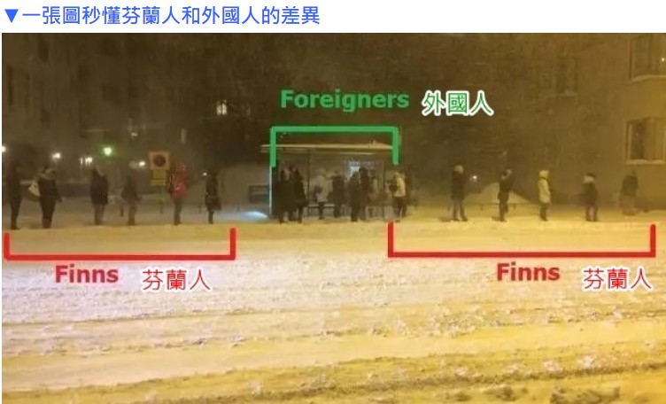
Conventional Social Distancing with
Finnish Contact
Social Distancing
"Distance is polite", line up at least 1 m apart
https://kknews.cc/world/4n35bb3.html

Slide 8












COVID-19 containment
3
Suspicious contact history in isolation zone
1
Decline number of participants
4
Social distancing
2
Quarantine
5. Wear a mask & wash your hands frequently

Slide 9

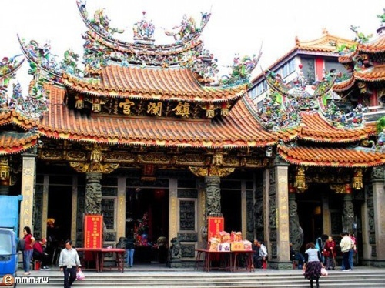
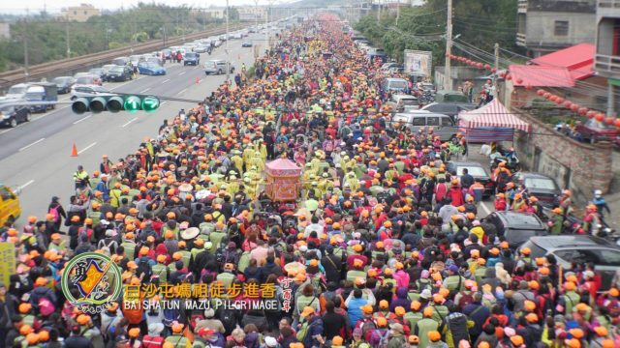
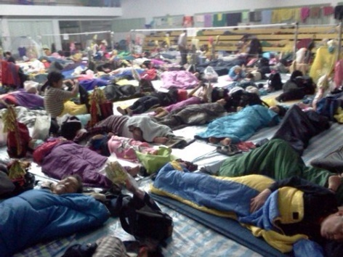
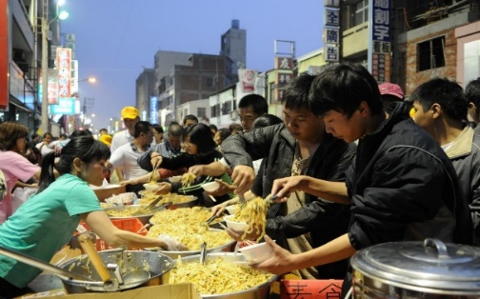
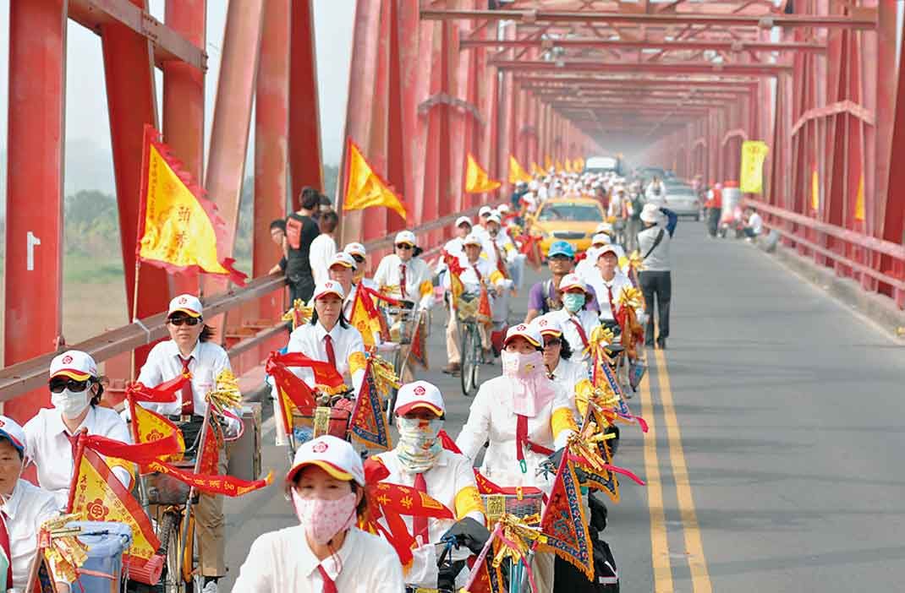
Large-scale public gathering—Buddhist Religion
Dajia Matsu Pilgrimage
~ About 2 millions attendees every year

Slide 10








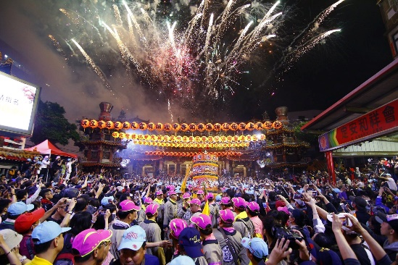

Large-scale public gathering for Buddhism
Transmission probability
Potential Infectives
Dense Population
Duration
New Infectives

Slide 11
Mitigation Plan for Large-scale public gathering for Buddhism
Advices
1. Fever Screening
2. Contact History Survey
3. Keep social distancing
POSTPONED
until …

Slide 12
Efficacy of Social distancing in
Reduction Risk of Infection
1300 infectives

Slide 13
Recommendations and Summary
Awareness of personal protection form COVID-19 has cultural difference and it takes time for adaption.
Public Gathering should be avoided to reduce community-acquired infection
Social distancing is required for reducing the risk of transmission for important and necessary public gathering. Evaluation of effectiveness in social distancing is stronbgly recommended.

